Slide 1



Solar Energy Prediction-ML

Slide 2

Learning Objectives
The goal of this project is to build a web application that can predict solar energy output based on various weather and time features, using machine learning.
The application must provide both a modern, interactive website (frontend) for users and a backend (server) that handles prediction requests by running a trained ML model.
GOAL
Source :
www.freepik.com/

Slide 3
Tools and Technology used
ML Training: Python, scikit-learn, pandas, numpy, pickle
Backend: Node.js, Express.js, csv-parser, cors
Frontend: HTML5, CSS3, JavaScript, Chart.js
Version Control: Git and GitHub (GitHub repo: solar energy prediction) to manage code and

Slide 4
Methodology
Data Generation and Feature Engineering
A synthetic dataset of 300 hourly records was created, simulating solar energy data for January 2023.
Feature engineering was performed to improve predictive power:Extracted time-based features: hour, weekday, day, month, and cyclical encoding to capture daily cycles. Environmental / weatherfeatures : temperature, humidity, cloud_cover ,solar_irradiance wind_speed, etc. Rolling averages for solar_irradiance, temperature, cloud_cover.
ML Model Training The project used a Random Forest Regressor (an advanced, ensemble-based machine learning model) for prediction, built using the engineered dataset.
Data was split (80% for training, 20% for testing). The model reached around 94% accuracy (R² score) on test data.
The model was saved (model.pkl) and integrated into the backend.
Web Application Development
Backend: Built with Node.js and Express.js.
Frontend: Built with HTML, CSS, and JavaScript.

Slide 5
Problem Statement:
Developing an accurate, interactive web-based system for solar energy prediction remains a significant challenge for both researchers and energy practitioners. The prediction of solar energy output is complicated by the variability of weather conditions and daily/seasonal patterns, making it difficult for end-users, researchers, or utilities to plan energy usage, grid integration, or system performance.
There is a need for a user-friendly yet advanced solution that can:
Ingest time and weather data,
Automatically engineer relevant features,
Apply powerful machine learning algorithms for accurate forecasting,
And present predictions and insights through a modern, accessible web interface.

Slide 6
Solution:
This project provides a complete web application for accurate solar energy prediction and visualization, featuring:
Data Simulation and Feature Engineering
Generates a synthetic solar energy dataset with 300 hourly records, including environmental, temporal, and solar-related features.
Performs advanced feature engineering such as extracting hour, weekday, rolling averages, cyclical (sin/cos) encoding, and daylight indicators to capture patterns relevant to solar energy forecasting.
Machine Learning Model
Trains a Random Forest Regressor on the engineered dataset to predict solar energy output based on all relevant factors.
Achieves high prediction accuracy (~94%), providing reliable estimates of future solar energy output.
Backend Development (Node.js + Express)
Implements an Express.js API server that:
Serves user requests for data and predictions.
Loads and utilizes the trained machine learning model for real-time inference.
Handles feature processing transparently to users.
Frontend Dashboard (HTML, CSS, JavaScript, Chart.js)
Offers a modern, interactive dashboard that:
Visualizes the dataset and model outputs using Chart.js for trends, distributions, and relationships.
Allows users to input custom weather and time features to generate real-time solar energy predictions.
Presents project, model, and data information clearly.
User Experience and Accessibility
Delivered as a single ZIP file with complete documentation, easy setup, and all dependencies included.
Ready to run locally in VS Code with minimal setup, suitable for demos, education, and further development.

Slide 7
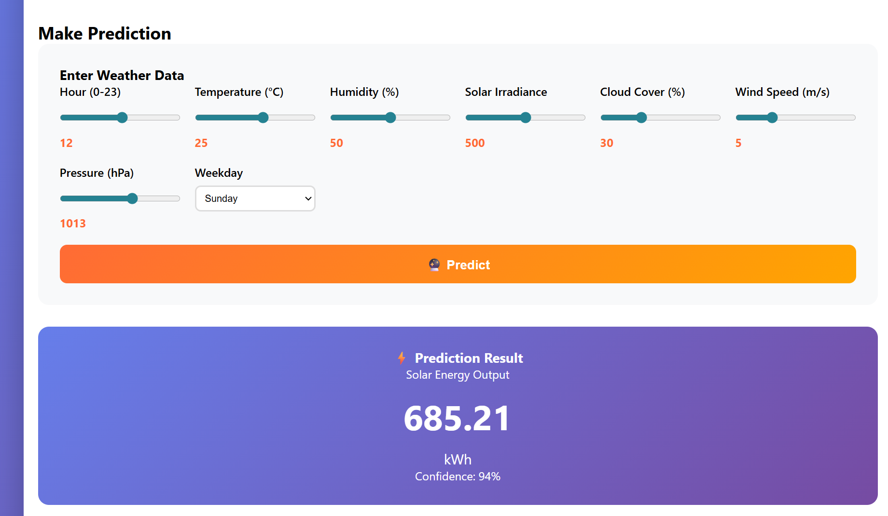
Screenshot of Output:

Slide 8
Conclusion:
This project successfully demonstrates how machine learning and modern web technologies can be combined to solve real-world forecasting challenges in the renewable energy sector. By simulating and engineering a robust solar energy dataset, training a high-accuracy Random Forest regression model, and deploying it with an interactive full-stack web application
Reliable solar energy predictions based on key weather and time features,
Powerful data visualization and exploration tools,
Real-time, user-driven predictions in a browser-friendly dashboard,
A portable, easy-to-run package that can be used for education, experimentation, or as a foundation for deeper research.

